Slide 1
✷..° ☆· · . · °•
.✦ * °. ✧• · ✦ . ✧
Convivial Coding for beginners with p5.js

Slide 2
Resources/tutorials:
nynnechristoffersen.com/files

Slide 3
Agenda·°·*❁✿❀❁✿❀
Hi intro welcome
Creative coding with. P5.js
Snack break
Exercises
Round up + Resources to keep learning

Slide 4
𓅰 𓅬 𓅭 𓅮 𓅯
Hi my name is Nynne, what's yours?

Slide 5
p5.js
𓆬𓆦𓆣𓆤𓆧𓆨𓆑

Slide 6
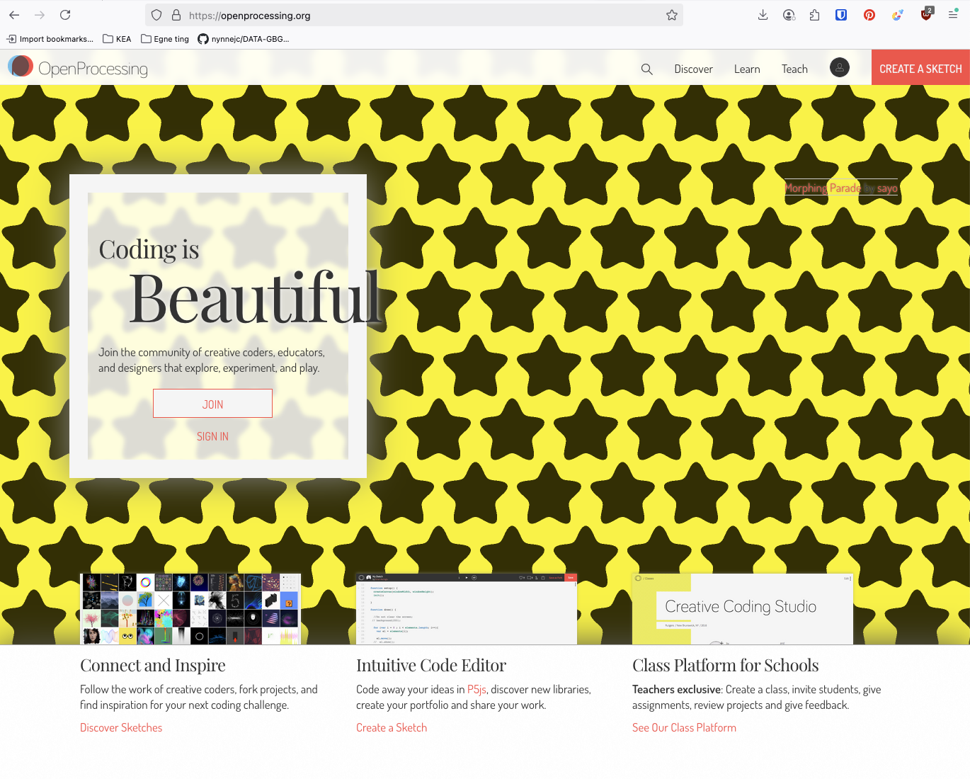
p5.js
p5.js is a library that lets you draw graphic shapes and interactive graphic design and generative art for the screen, with code.
Creative Coding
https://openprocessing.org/
https://exp.paperdove.com/chillin/

Slide 7
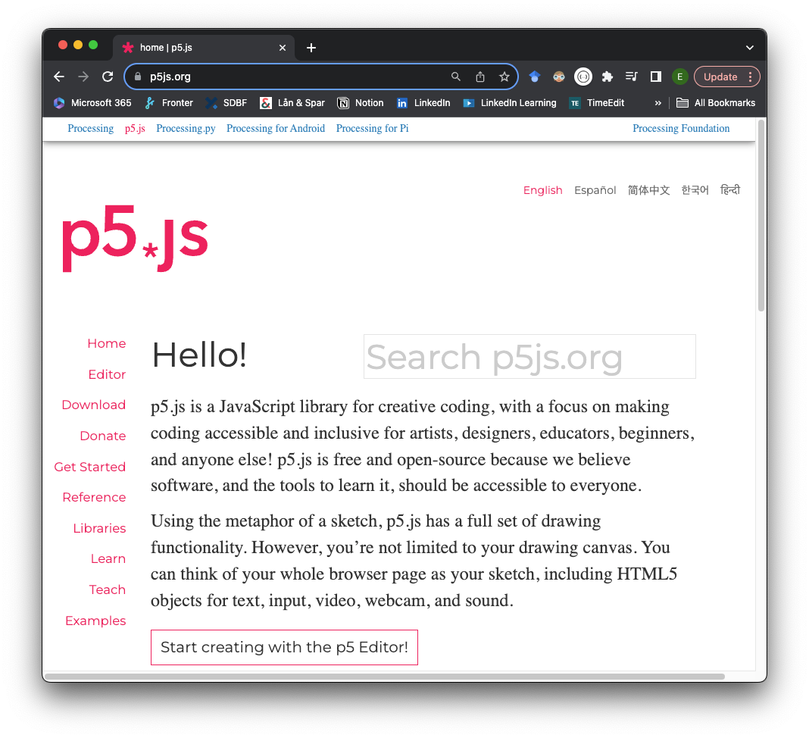
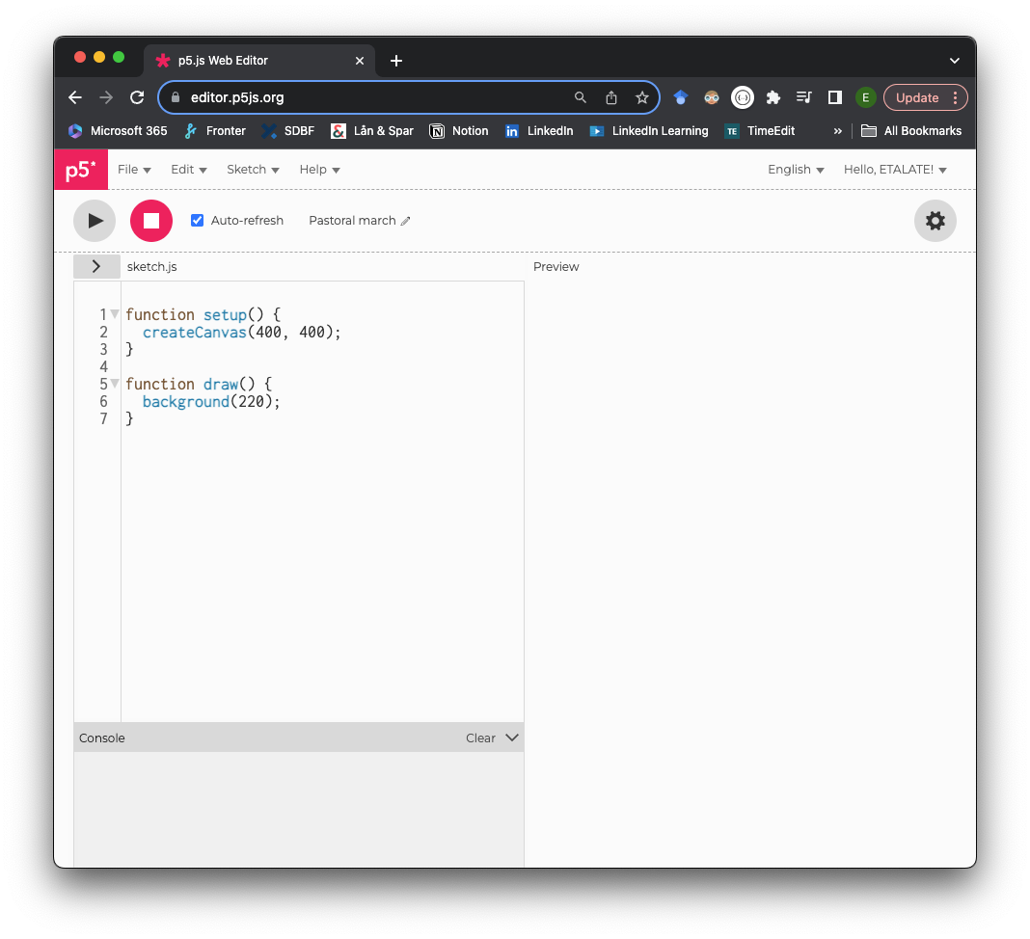
p5.js
https://p5js.org/
https://editor.p5js.org/
You must login to use it!

Slide 8
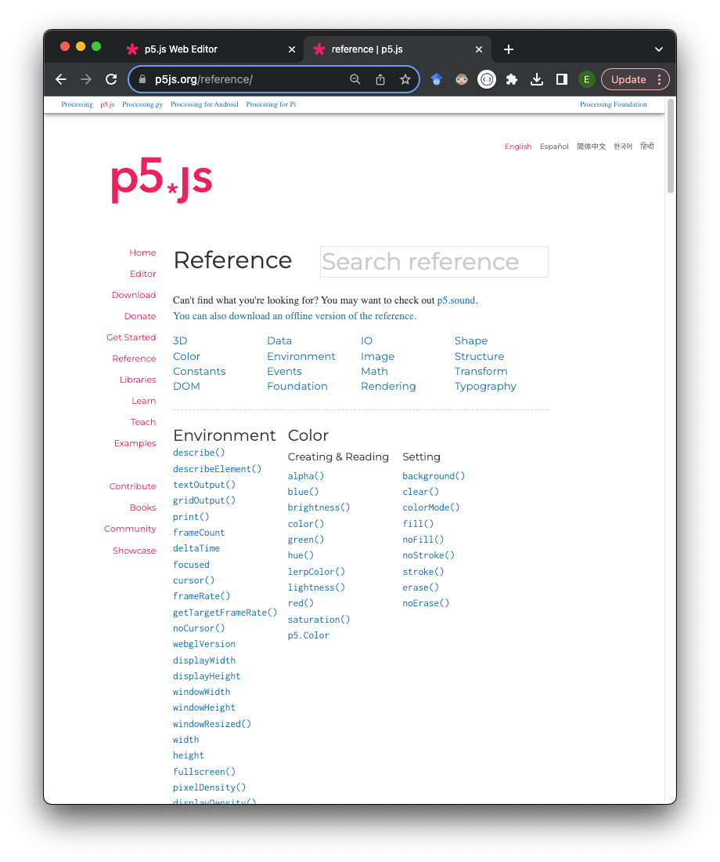
Our first sketch
setup()
  Is called as the first thing when the program runs. Usually contains start variables and functions e.g. Background color and screen size. Can only be called once.
createCanvas()
  Called only once. Must be placed in the setup() function. Creates a canvas with dimensions in pixels. Without parameters, canvas becomes 100x100 pixels.
draw()
  Runs the code inserted in the body in a loop until noLoop() is called.
background()
  Sets the background color. If not used, the background is transparent. A number is understood as grayscale and string as CSS color. Three parameters RGB (default), HSB or HSL.
https://p5js.org/reference/

Slide 9
Our First Sketch: Shapes ⟡▲●⬥⛋⬤◙◒❒◼⬟▪▦⧉

Slide 10
Shapes
line()
  Syntax: line(x1, y1, x2, y2)
    Draws a line
    Has no weight / size and therefore cannot use fill(). Instead, use stroke() to change the color and strokeWeight() to change the width of the line.
circle()
  Syntax: circle(x, y, d)
    Draws a circle
    The first two parameters define the location of the center of the circle. Third parameter defines the diameter of the circle.
    Alternative to ellipse()
square()
  Syntax: square(x, y, d)
    Draws a square
    The first two parameters define the location of the square's upper left corner. Third parameter defines the length of the side of the square.
    Alternative to rect()

Slide 11
△〇□
live coding
Line, circle & square

Slide 12
Exercise ✧･ﾟ: *✧･ﾟ:* ‧͙⁺˚*･༓☾

Slide 13
Solution for the exercise𓆝𓆟𓆞𓆝𓆟

Slide 14
•· •·° . •*✵✷★.°•.*° ✷ ☆ ✯*• °*.* *°°.• · °·*
Snack Break

Slide 15
𓇢𓆸 Movement and Interactivity

Slide 16
Movement and Interactivity
How do we make something move?
Re-positioning our form
Using our draw() function's loop

Slide 17
Movement and Interactivity
How do we make something interactive?
Take input from mouse or keyboard
Use built-in I/O functions and variables in p5.js, for example mouseIsPressed

Slide 18
live Code ⛋
Moving rectangle

Slide 19
Exercise ✧･ﾟ: *✧･ﾟ:* ‧͙⁺˚*･༓☾

Slide 20
Solution for the exercise
────୨ৎ────

Slide 21
•· •·° . •*✵✷★.°•.*° ✷ ☆ ✯*• °*.* *°°.• · °·*
Snack Break

Slide 22
ADVANCED
Adding a sketch to a website
𓇼𓆡⋆.˚𓇼⋆.˚𓆉𓆝

Slide 23
Text editor ≽༏≼ ๑ï 𖢥 𐦍 𓆨.𖥔 ݁ ˖
For this exercise you’ll need a code text editor, if you don’t already have one:
Try Sublime
Or VSCode

Slide 24
Our files ₊˚⊹♡✶⋆.˚
index.html
style.css
sketch.js

Slide 25
Index.html ⃝✵
<!DOCTYPE html>
<html>
<head>
<title>Creative Coding Yay!</title>
<link rel="stylesheet" href="./style.css">
<meta name="viewport" content="width=device-width, initial-scale=1.0">
<title>Softer Creative Coding Course</title>
<script src="https://cdn.jsdelivr.net/npm/p5@2.0.0/lib/p5.min.js"></script>
</head>
<body>
<h1>Hey hi!</h1>
<h2>Look at my beautiful drawing</h2>
<script src="sketch.js"></script>
</body>
</html>

Slide 26
style.css 𖦹
body, html {
margin: 0;
padding: 0;
height: 100%;
overflow: hidden;
}
canvas {
position: fixed;
top: 0;
left: 0;
z-index: -1;
}

Slide 27
sketch.js ⃝𖤐
In here we will add code from our favorite sketch

Slide 28
⊹₊˚‧︵‿₊୨ᰔ୧₊‿︵‧˚₊⊹
Thank you!
Happy Coding p5js Tutorials
The Coding Train Youtube

